Slide 1
The Case Analysis Workshop
GERESE TEAM
Didier M. Valdes, Willian Frey,Jorge J. Ferrer, Erika C. Jaramillo
University of Puerto Rico at Mayagüez

Slide 2
Agenda
Introduction
Background
Methodology
Assessment
Results
Conclusions
Acknowledgments

Slide 3
Introduction
3
American Society for Engineering Education - 2009
There have been several cases of serious research misconduct.
Research misconduct can seriously and negatively influence society as a whole.
In a world of global changes and global impacts, training in research ethics should be central to the education in science and engineering.
It is necessary to introduce graduate students in science and engineering to basic issues in research ethics.
Notes:
3

Slide 4
Introduction
4
American Society for Engineering Education - 2009
Project at the University of Puerto Rico at Mayaguez: Graduate Education in Research Ethics in Science and Engineering (GERESE) sponsored by NSF
Graduate Awareness Workshop (GAW)
Moral Deliberation Workshop (MDW)
Case Analysis Workshop (CAW)
Ethics Banquet (EB)
Notes:
4

Slide 5
…a double axiological axis
Scientific activity and ethics are connected by reasons intrinsic to scientific work
Research ethics gravitates around a double axiological axis.
axis of truth
axis of social responsibility
Double axis framework responds to the ethical objective of stimulating moral awareness by helping students to classify and identify ethical issues in research.
Also guides the design of our educational plan for these workshops

Slide 6
…a double axiological axis
Axis of Truth | Axis of Social Responsibility
Academic Integrity (Epistemic Research Values) | Responsibility Issues | Research Environment Issues
Confidentiality Integrity Intellectual Property Authorship Copyright Patents Trade marks and trade secrets Fabrication Falsification Plagiarism | Research with human subjects and human cells Vulnerable populations Informed consent Use of animals in research Public policy Commitment and relationship to industry Environmental protection | Mentorship Peer review Conflict of commitment Conflict of interest Responsible scientific record keeping

Slide 7
Previous work in moral psychology…
Educators in professional ethics are turning to skills-based approaches in moral pedagogy.
Hastings Center list [14]:
1. A practiced and refined moral imagination
2. Moral sensitivity and awareness
3. Skill in analyzing moral concepts and principles.
4. Eliciting a sense of responsibility.
5. Ability to deal with moral ambiguity and disagreement while working toward clarity and agreement.
These skills are developed through classroom activities that use realistic ethics cases.

Slide 8
Importance of Case Analysis…
Case analysis incorporates frameworks and principles from the Responsible Conduct in Research (RCR) approach by…
uncovering the ethical reasoning behind the RCR rules,
presenting skills pertinent to moral deliberation,
providing tools to deal with moral ambiguity and disagreement,
helping students distinguish between morally conflicting situations, moral disagreements, and moral problems.
Building these objectives onto RCR rules, thus, responds to
concerns expressed by the Council of Graduate Schools [7].
American Society for Engineering Education - 2009

Slide 9
Methodology for Case Analysis
The Case Analysis Workshop includes:
Case presentation and pre-test
ethics case video [11]
follow-up question and answer
pre-test
Recapitulation of previous workshop
Review of ethical approaches and concepts
Presentation of moral deliberation method (Ferrer)

Slide 10
Methodology for the Case Analysis
10
Moral deliberation method steps (Ferrer):
(1) Determination of facts
(2) Identification of morally problematic situations
(3) Identification of possible courses of action
(4) Identification of moral disagreements and problems in each course of action
(5) Determination of values at play and hierarchy of principles and duties
(6) Weighing consequences (if necessary)
(7) Decision justification
American Society for Engineering Education - 2009
Notes:
10

Slide 11
Methodology for Case Analysis
11
American Society for Engineering Education - 2009
Presentation of research misconduct cases
Hypothetical situations progressively complicated
Role-playing case (Dr. Swift) [4]
Post-test
Repetition of pre-test to measure improvement during workshop
Workshop Assessment
A rubric has been developed to assess this workshop
Notes:
11

Slide 12
Hypothetic situation with progressive complexity
The contaminated lot case
Start with simple situation as core
You work for a pharmacy company. Just before the shipment you discover a contaminated lot. What should you do?
Add layers of complexity
Low risk of getting caught
High risk that someone could be harmed by contamination
Causes further delays in product delivery
You could get fired
Your daughter is sick and needs your medical plan
American Society for Engineering Education - 2009

Slide 13
Role play case (Dr. Swift Case)
Rashomon- Type cases
Morally conflicting situation described from multiple participant standpoints (no single narrative to work from)
Translated into Spanish
Six participant-narratives
Students study their assigned role from standpoint of narrative
Role-play narrative in a setting of dramatic confrontation

Slide 14
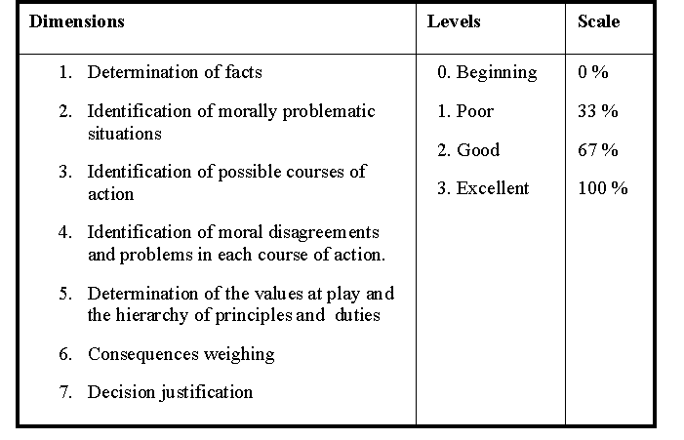
A Rubric….
14
Table 1. Characteristics of the rubric used as assessment tool.
American Society for Engineering Education - 2009
Notes:
14

Slide 15
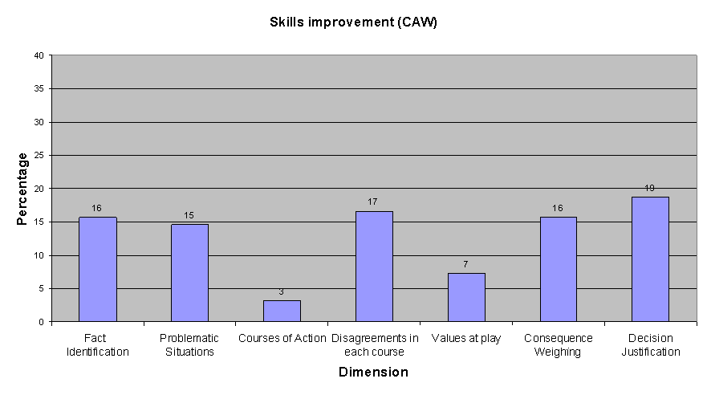
Results CAW

Slide 16
Analysis of Results
Determination of fact:
participants showed a 15.6% improvement, demonstrating that they did not initially take into account the entire situation and its participants but later incorporated these into their analysis
Identification of moral disagreements:
a 16.6% improvement shows that students learned to distinguish between moral questions, moral disagreements, and moral conflicts
Identification of morally problematic situations:
a 14.6% rate of improvement demonstrates that students improved their ability to recognize situational conflicts in morally problematic contexts
American Society for Engineering Education - 2009

Slide 17
Analysis of Results
Improvement in consequence analysis:
a 15.6% shows that students began to take into account a larger range of consequences in their decision-making including long range impacts in such macroethical areas as the natural environment and future generations.
Decision justification:
(18.6%), a crucial skill given the importance of explaining and validating professional decisions in today’s pluralistic society.
General Analysis:
Improvements in the first six steps composing this conceptual
framework in decision-making show that the workshop has
helped students to make good ethical choices and to
accompany these choices with strong critical, justificatory
arguments.
American Society for Engineering Education - 2009

Slide 18
Conclusions
The Case Analysis Workshop (CAW) was developed as a tool for graduate students to practice moral deliberation
CAW builds upon theoretical knowledge of ethics to encompass the skills measured by pre- and post-tests
Case selection helps students think about research ethics and envision it in pluralistic, global, and social contexts.
Seven-step method of moral deliberation provides tools to sharpen reflection on research ethics and research misconduct.
American Society for Engineering Education - 2009

Slide 19
Bibliography
19
[1] Ferrer, J.J. (2007), “Deber y Deliberación una Invitación a la Bioética” Cep, Mayagüez, Puerto Rico.
[2] Lopez, E.D., Torres, D., and Roldan, A. (2007) “ El fraude en la ciencia: reflexiones a partir del caso Hwang “ El Profesional de la Informacion, Vol. 16, pp. 143-150.
[3] Dahllberg, J.E., and Mahler, C.C. (2006) “The Poehlman case: running away from the truth” Science and Engineer Ethics, Vol. 12 , pp. 157-173.
[4] “Introduction To The Responsible Conduct Of Research”, University Of Oklahoma Center for Applied Social Research, December 11-12, 2006, pp 52-55.
[5] Harris, C.E.; Pritchard, M.S. and Rabins, M.J. (1995) “Engineering Ethics: Concepts and Cases” Wadsworth Publishing Co Inc, Belmont, California.
[6] Herkert, J.R. (2005),“Ways of Thinking about and Teaching Ethical Problem Solving: Microethics and
Macroethics in Engineering,” Science and Engineering Ethics, Vol. 11, pp. 373-385.
[7] Tate, P.D. and Denecke, D.D. (2006), “Graduate Education for the Responsible Conduct of Research”. Council of Graduate Schools, Washington D.C.
[8] Callahan, D. (1980). Goals in the teaching of ethics. In D. Callahan & S. Bok (Eds) Teaching in Higher
Education. Plenum, New York, pp. 51-74.
[9] Werhane, P. (1999). Moral Imagination and Management Decision Making. Oxford University Press, Oxford.
[10] Johnson, M. (1993) Moral Imagination: Implications of Cognitive Science for Ethics. Chicago University Press, Chicago.
[11] Video tape Professional Ethics and Engineering, Funded by: The National Science Foundation, Ethics and Values Studies, Produced by: The Program in Science, Technology and Human Values, Duke University, Directed by Kevin Dill, Produced by Scott Wells, Written by P. Aarne Vesilind.
[12] Ferrer, J.J. and Alvarez, J.C. (2003), “Para Fundamentar la Bioética” Comillas, Madrid, España.
[13] Vallero, D. A. (2007), “Biomedical Ethics for Engineers”. Elsevier Inc, San Diego, California.
[14] Pritchard, M. (1996). Reasonable Children. University of Kansas Press, Lawrence, KS.
American Society for Engineering Education - 2009
Notes:
19

Slide 20
Acknowledgments
Support from NSF (SES 0629377)
Collaboration of the other members of the GERESE team:
Efrain O’Neill
Carlos Rios, and
Morgan Echeverry
American Society for Engineering Education - 2009

